Slide 1

Sustainability and Natural Resources
Module 4
© 2020 McGraw Hill. All rights reserved. Authorized only for instructor use in the classroom.
No reproduction or further distribution permitted without the prior written consent of McGraw Hill.

Slide 2
Learning Objectives
4-1 Describe environmental sustainability and its potential influence on business.
4-2 Describe frameworks for sustainability.
4-3 Summarize ways to measure sustainability achievements.
4-4 Identify the characteristics of environmentally sustainable business.
4-5 Describe how the stakeholder model can help businesses achieve sustainability.
4-6 Describe how geographic features of a country or region contribute to natural capital.
4-7 Outline nonrenewable and renewable energy options available and their potential impacts on business.

Slide 3
Sustainability No Longer Just a Buzz Word for Business
In today’s business environment, the concept of sustainability goes beyond doing what’s right for the planet or complying with government regulations.
For many global companies, sustainability has become an important component of their overall business model, with a direct impact on their bottom line. Savvy consumers have high expectations when it comes to buying products and services from companies that claim sustainability is an important part of their business practices.

Slide 4
Sustainability in the Business Context
Environmental Sustainability
State in which the demands placed upon the environment by people and commerce can be met without reducing the capacity of the environment to provide for future generations.
Brundtland Commission
Definition of sustainable development:
“It meets the needs of the present without compromising the ability of future generations to meet their needs.”

Slide 5
Systems for Achieving Sustainability 1
Life Cycle Assessment
An evaluation of the environmental aspects of a product or service throughout its life cycle.
Assesses the cumulative impact of product.
Can lead to reductions of environmental footprint, cost structure, and potential carcinogens in inputs, processes, and wastes.
Emerging “product stewardship” shows companies accepting responsibility for impact of their activities.

Slide 6
Systems for Achieving Sustainability 2
Cradle-to-Cradle Design
Suggests that products and services should be designed to completely close the production loop, so that all resources needed to produce them are recycled and reused rather than discarded or left to pollute.
Identifies two components:
Technical nutrients.
Biological nutrients.

Slide 7
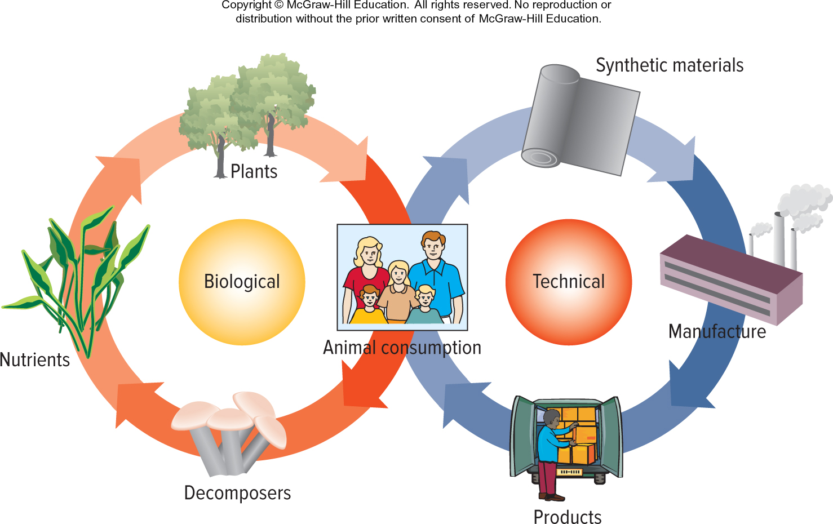
Figure 4.1 C2C Model
Access the text alternative for slide images.
Notes:
The concept of C2C is captured in the phrase “Waste = Food.”

Slide 8
Critical Thinking Question
Why is it challenging to measure how successfully a business is practicing sustainability?
Notes:
To be most meaningful, the measures have to be able to serve as a basis for comparisons. That is, the platforms have to meet comparability test. Note that 3BL does not meet this criterion. Designing a platform that can function across sectors is difficult, since it involves many variables. Successful platforms include the Global Reporting Initiative, the Global Compact, and the Carbon Disclosure Project.

Slide 9
Tools for Measuring Sustainability 1
United Nations Global Compact
A voluntary reporting scheme for businesses that covers critical areas affecting the conduct of international business—human rights, labor, the environment, and anticorruption efforts.
Global Reporting Initiative
Sustainability reporting framework developed among stakeholders.

Slide 10
Tools for Measuring Sustainability 2
Carbon Disclosure Project
Organization that provides reporting frameworks for greenhouse gas emissions and water use.
Carbon Footprint
A measure of the volume of greenhouse gas emissions caused by a product’s manufacture and use.
Water Footprint
A measure of the amount of water used in a product’s manufacture and use.

Slide 11
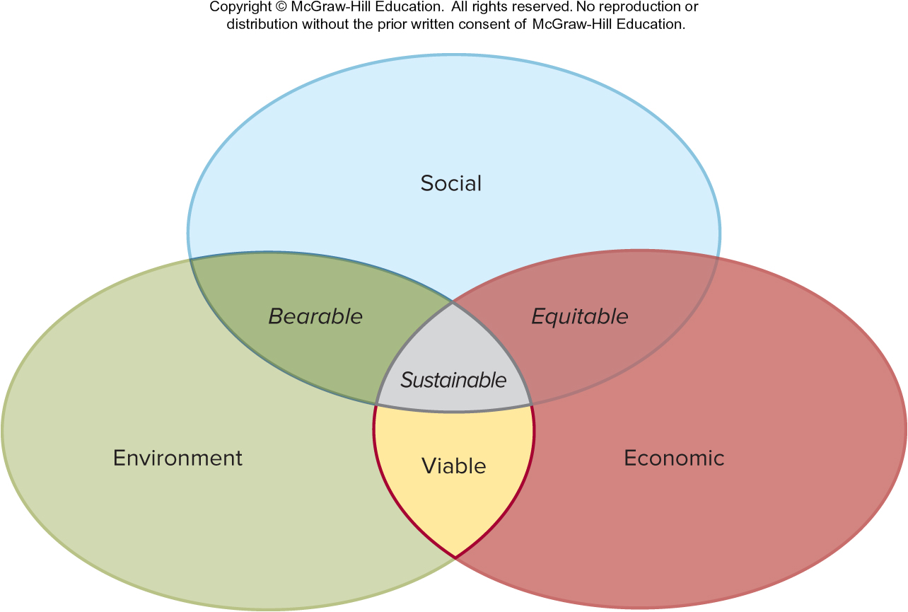
Figure 4.2 Context for Sustainability
Source: Adams, W. M., “The Future of Sustainability: Re-Thinking Environment and Development in the Twenty-first Century,” IUCN, January 29–31, 2006.
Access the text alternative for slide images.

Slide 12
Characteristics of Environmentally Sustainable Business 1
Limits as Part of the Sustainability Context
Limits address the reality that environmental resources are exhaustible.
To recognize the limits of the earth’s atmosphere to absorb emissions, and to incorporate this recognition into the way the business operates, is an ecologically responsible decision that supports sustainability.

Slide 13
Characteristics of Environmentally Sustainable Business 2
Interdependence as Part of the Sustainability Context
The complex relationships that sustainable practices create among ecological, social, and economic systems, in which actions in one of these systems may affect the other two, often in ways that are not easily predicted.

Slide 14
Characteristics of Environmentally Sustainable Business 3
Equity Distribution as Part of the Sustainability Context
For system interdependence to work, there cannot be vast differences in the distributions of gains.
Example: Fair Trade movement.
Global world demands increasing transparency.
Backward integration to gain control over supply chain.

Slide 15
The Stakeholder Model for Sustainable Business 1
Stakeholder Theory
An understanding of how business operates that takes into account all identifiable interest holders.
Managers should consider the network of tensions caused by competing internal and external demands that surrounds the business.
Gives all stakeholders a voice.

Slide 16
The Stakeholder Model for Sustainable Business 2
Triple-bottom-line accounting (3BL)
Measures the firm’s social and environmental performance in addition to its economic performance.
Does not allow for comparisons across companies because measurements, especially social and environmental areas are not standardized.

Slide 17
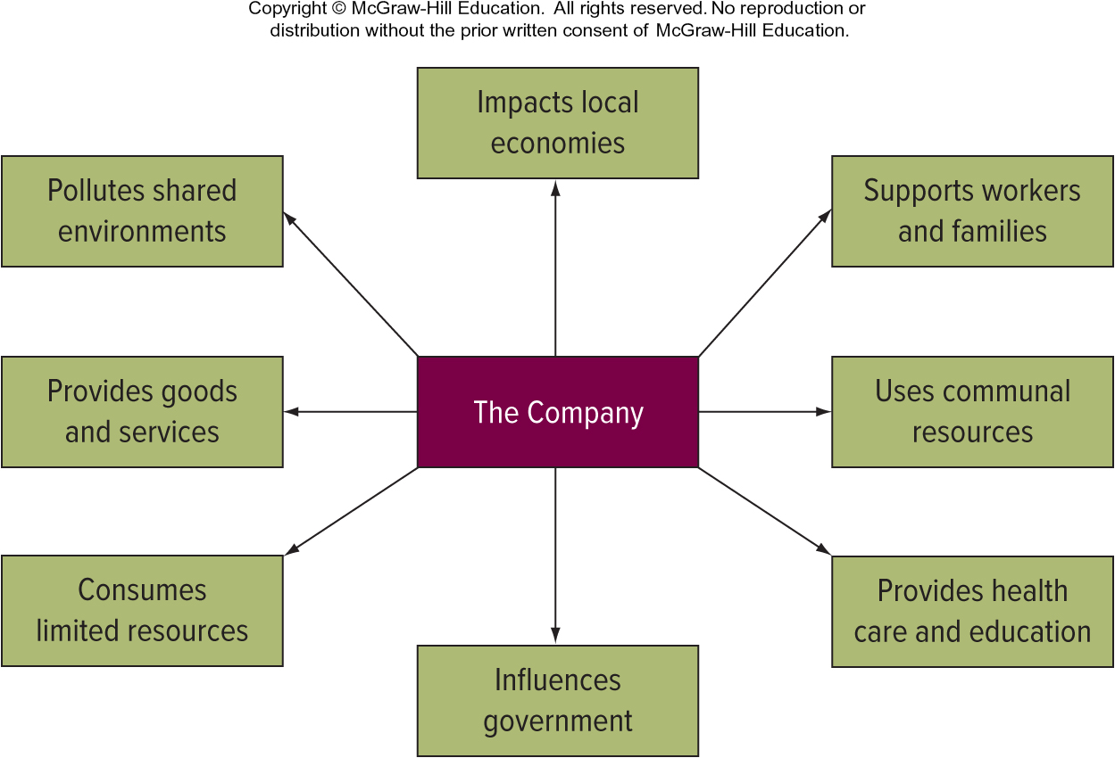
Figure 4.5 The Company in a Societal Context
Access the text alternative for slide images.

Slide 18
Geography: Describing Our Natural Capital 1
Natural Capital
Natural resources such as air, land, and water that provide us with the goods and services on which our survival depends.

Slide 19
Geography: Describing Our Natural Capital 2
Location: Political and Trade Relationships
Location can contribute to country’s competitive advantage.
Obvious to trade with neighbors.
Austria’s political neutrality made it a good location during Cold War.
Geographic proximity affects formation of trading groups.

Slide 20
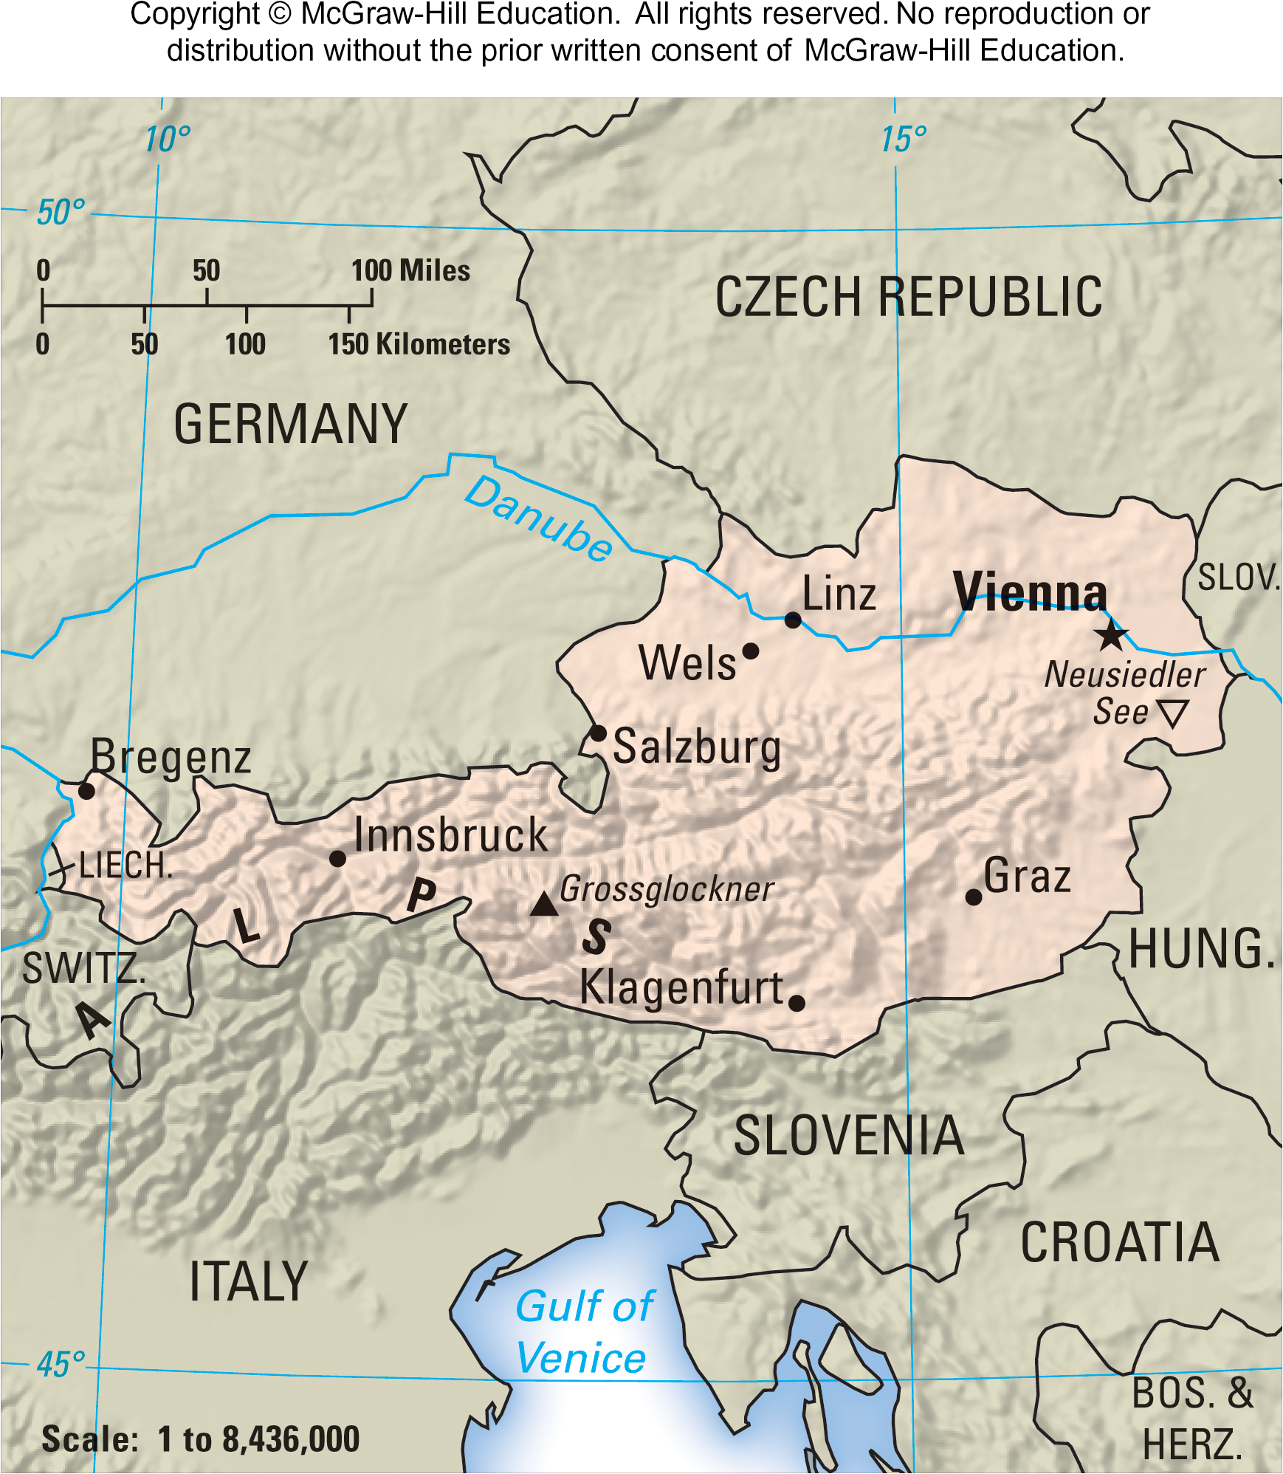
Figure 4.6 Cold War Austria

Slide 21
Geography: Describing Our Natural Capital 3
Topography: Mountains
Separate people, impede exchange and interaction.
Results in language and culture differences.
Create regional markets, often with altitude adjustments.

Slide 22
Geography: Describing Our Natural Capital 4
Topography: Deserts and Tropical Forests
Separate markets.
Increase cost of transportation.
Create population concentrations.

Slide 23
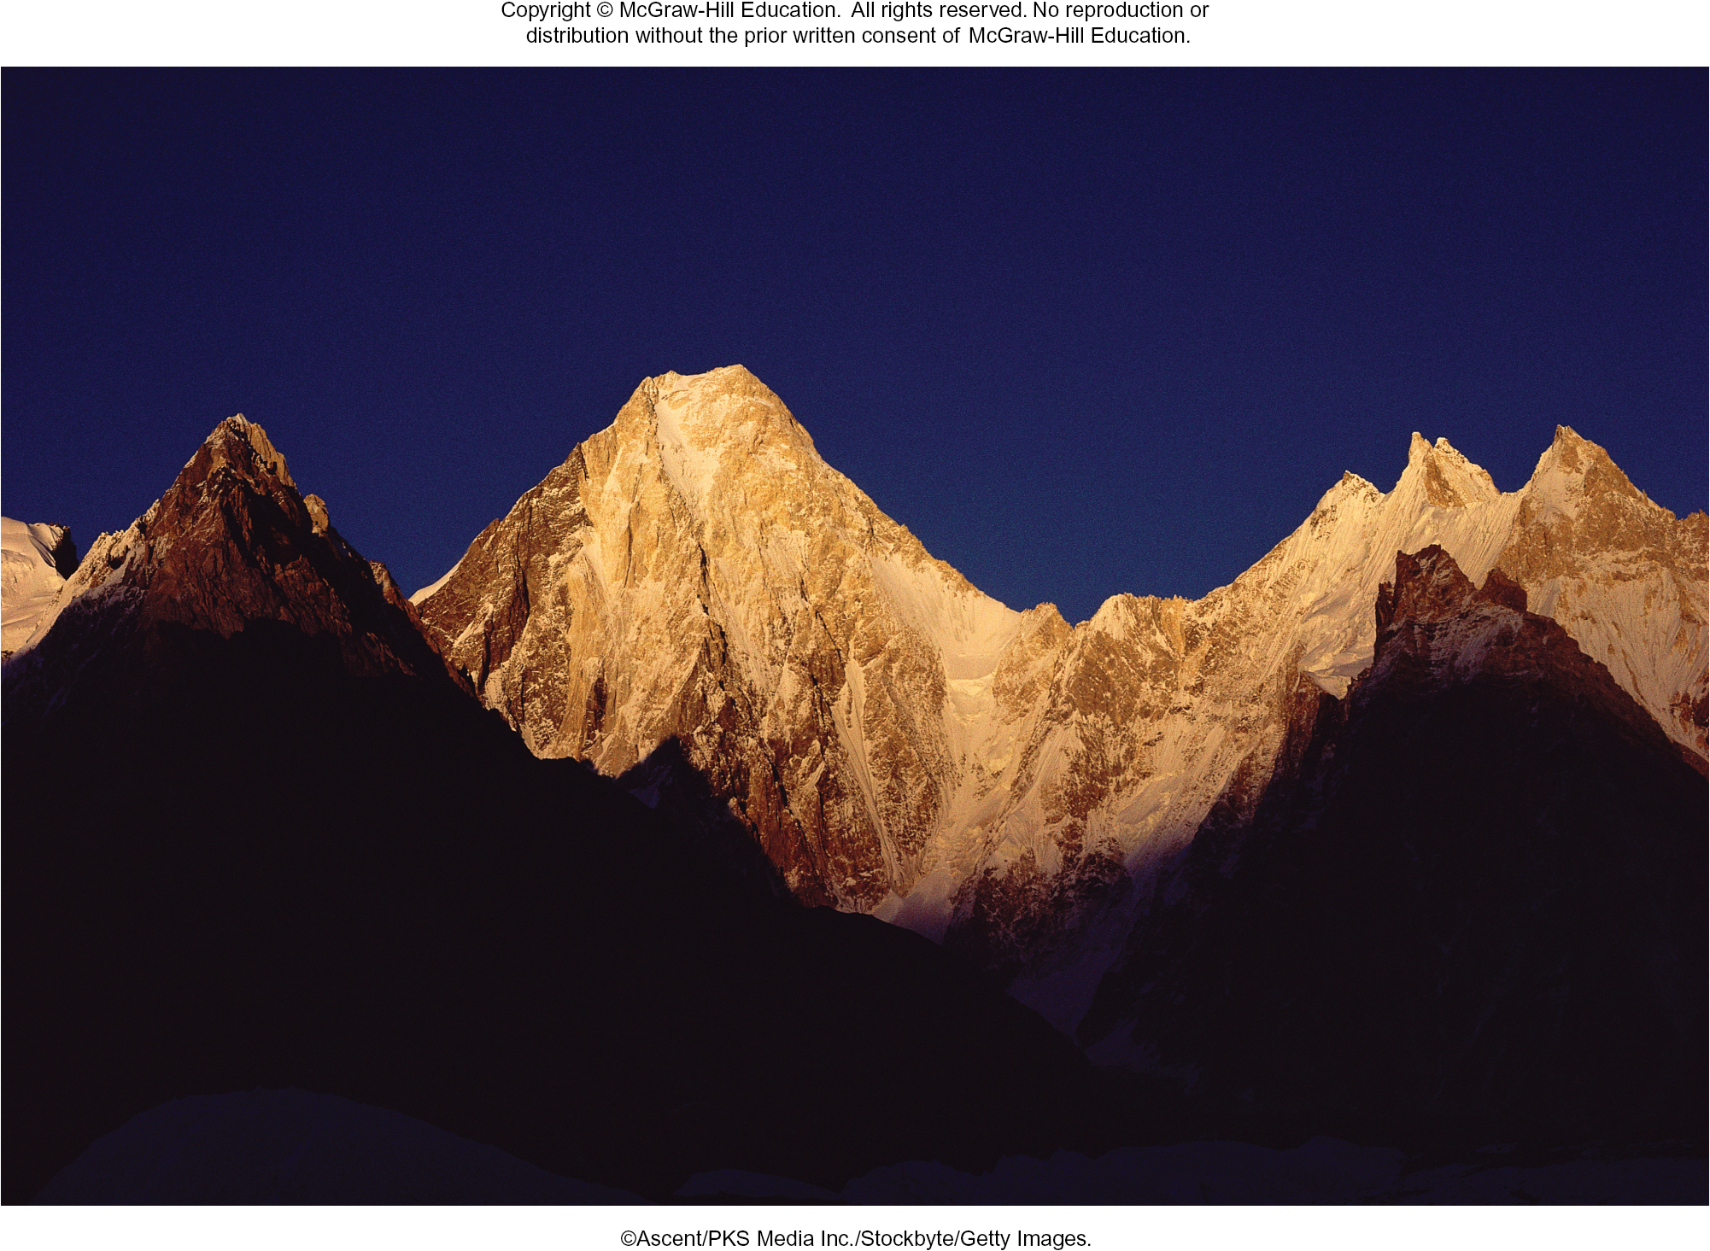
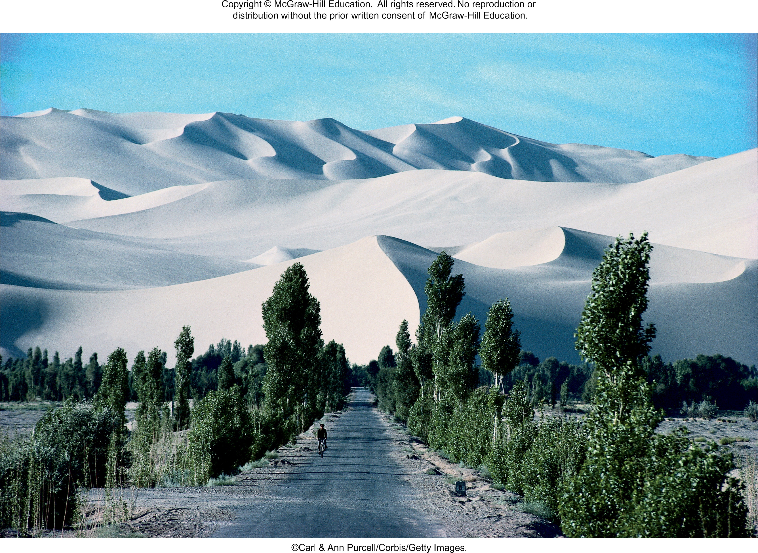
Topography
©Ascent/PKS Media Inc./Stockbyte/Getty Images
©Carl & Ann Purcell/Corbis/Getty Images
The Central Asian Hindu Kush runs from north central Pakistan through eastern and central Afghanistan.
The Green Wall of China, in Taipuisa, Inner Mongolia, planted to fend off the encroaching Gobi desert.

Slide 24
Geography: Describing Our Natural Capital 5
Topography: Bodies of Water
Attract people.
Facilitate transportation.
Inland waterways provide access to interior markets.

Slide 25
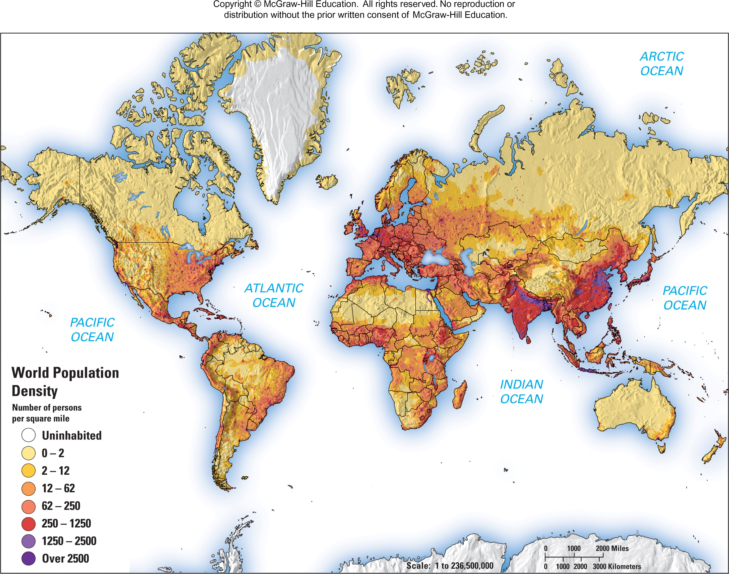
Figure 4.7 World Population Map
Access the text alternative for slide images.

Slide 26
Geography: Describing Our Natural Capital 6
Climate
Meteorological conditions, including temperature, precipitation, and wind that prevail in a region.
North-South divide: greater economic and intellectual development has occurred in temperate climates of Northern Europe and U.S.

Slide 27
Natural Resources 1
Natural Resources
Anything supplied by nature on which people depend.
Renewable Energy
Energy that comes from sources that are naturally replenished, such as sunlight, wind, and water flow.

Slide 28
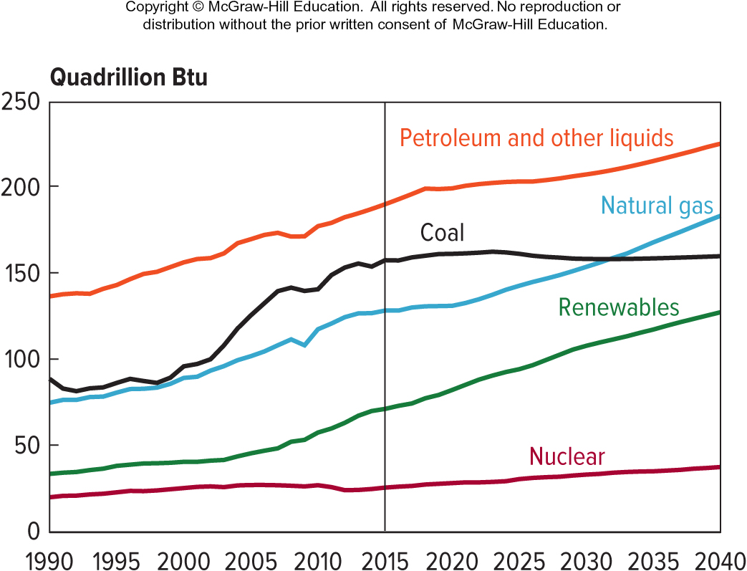
Figure 4.9 World Energy Consumption by Fuel Type, 1990 to 2040 (est.)
Source: “International Energy Outlook 2017,” U.S. Energy Information Administration, September 14, 2017.
Access the text alternative for slide images.

Slide 29
Natural Resources 2
Nonrenewable Energy
Energy that comes from sources that cannot be replenished, such as the fossil fuels—petroleum, coal, and natural gas—and nuclear power.

Slide 30
Natural Resources 3
Nonrenewable Energy Sources: Petroleum
How long will supplies last?
Oil shale has remained underdeveloped due to environmental issues.
Heavy oil does not flow easily, produced from oil sands and oil-bearing shale.
Fracking has opened new reserves.

Slide 31
Natural Resources 4
Nonrenewable Energy Sources: Nuclear Power
Data suggests many countries expanding nuclear capacity.
Main issue is safety.

Slide 32
Natural Resources 5
Nonrenewable Energy Sources: Coal
Projected to decline as energy source.
Emissions from burning coal responsible for global warming.
Nonrenewable Energy Sources: Natural Gas
Cleanest burning fossil fuel.

Slide 33
Natural Resources 6
Renewable Energy Sources
Predicted to be a shift toward renewable energy sources because either price of nonrenewable sources will become prohibitive or nonrenewable sources will become unavailable.

Slide 34
Natural Resources 7
Renewable Energy Sources
Wind power: now a mainstream source for electricity.
Biomass: energy source is photosynthesis.
Solar Photovoltaic Power (PV): power comes from voltage crated when certain materials are exposed to light.

Slide 35
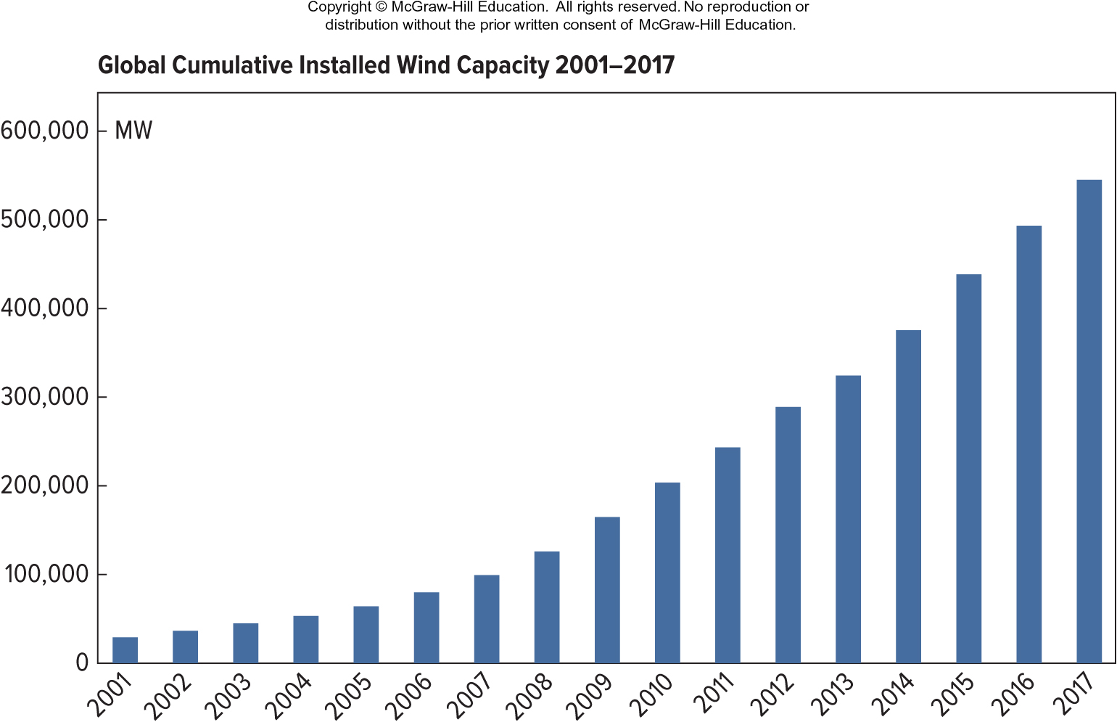
Figure 4.13 Global Wind-Generating Capacity, 2001 to 2017
Source: Global Wind Energy Council, “Global Statistics,” http://gwec.net, accessed September 18, 2018.

Slide 36
Figure 4.14 Global Solar-Installed Capacity in Gigawatts (GW), by Region, Beginning of 2016
Europe: 90,000+
Asia: 90,000
East Asia: 80,000
North America: 30,000
South East Asia and Pacific: 10,000
South and Central Asia: 8,000
Latin America and the Caribbean: 5,000
Africa: 5,000
Middle East and North Africa: 2,000
Source: World Energy Council, “Solar Installed Capacity by Region,” World Energy Resources 2016, https://www.worldenergy.org, accessed September 18, 2018.

Slide 37
Natural Resources 8
Renewable Energy Sources
Concentrating Solar Thermal Power (CSP): mirrors or lenses collect sunlight to heat water.
Geothermal Power: power from heat stored in the earth.
Ocean Energy: power from sun’s heat on the water and mechanical energy of tides and waves.
Hydropower: draws on energy of moving water.

Slide 38
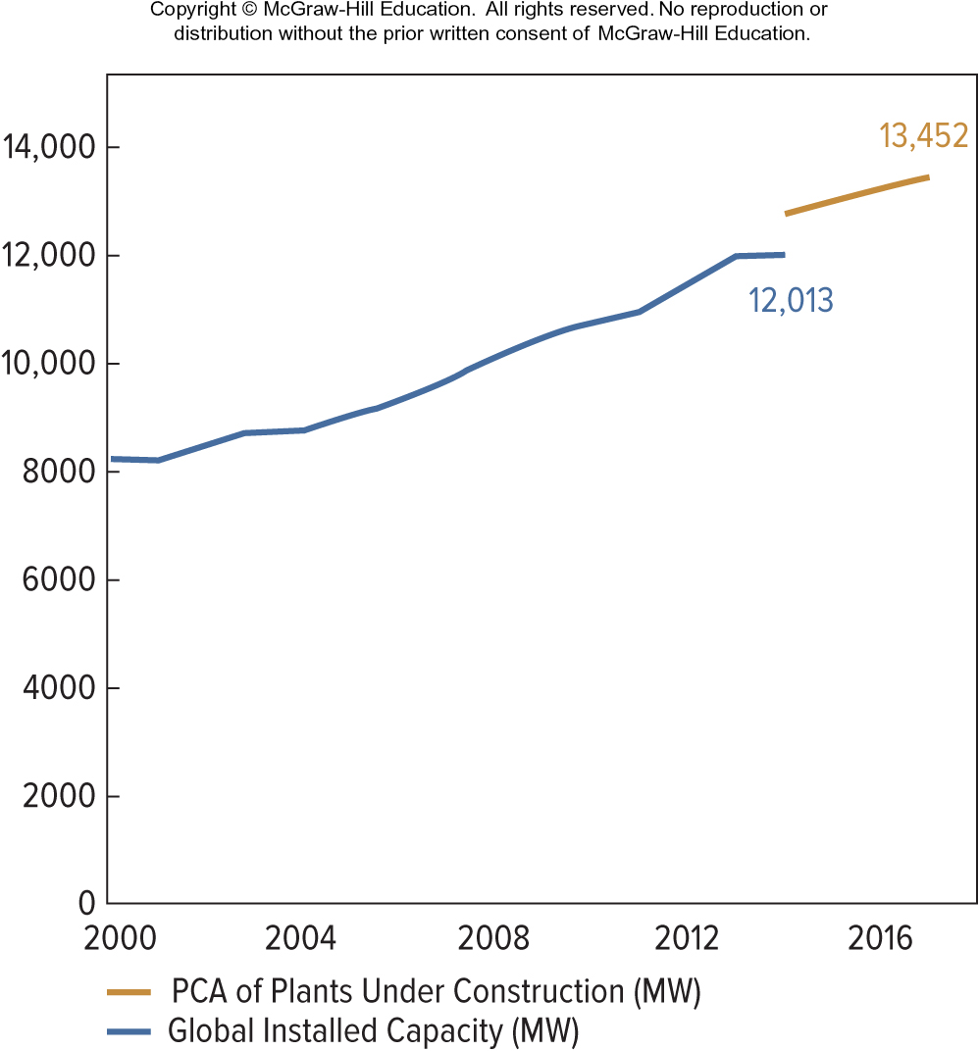
Figure 4.15 Worldwide Geothermal-Generating Capacity, 2000 to 2018
Source: Geothermal Energy Association, “Current Use,” http://geo-energy.org, accessed September 7, 2018.
Access the text alternative for slide images.

Slide 39
Natural Resources 9
Nonfuel Minerals
Rare earths are 17 nonfuel mineral elements used in defense applications and in all areas of modern manufacturing.
Insufficient concentrations prevent them from being commercially viable to mine.
China produces more than 80 percent of output.

Slide 40
Global Debate
This debate centers around the subject of greenhouse gas emissions. Scientific data shows that these emissions contribute to global warming and, if left unchecked, could not only make the planet hotter but could also disrupt rainfall patterns, raise sea levels, cause more powerful storms, intensify droughts which cause food shortages, and other extremes.
The United States produces nearly one-third of excess carbon dioxide present in the atmosphere and recently departed from the Paris Accord.
How might the relationship between more-developed countries and less-developed countries be impacted by working toward a common goal but with vastly different requirements?
Would it have been worth the time to specify what is expected of each country and put in place ramifications if these goals are not accomplished or attempted?
Notes:
1. Answers will vary, but one key issue is that less-developed countries have fewer financial resources to invest in alternative energy systems that do not emit carbon. More-developed nations have emitted massive quantities of carbon while they became more developed. Should less-developed countries be allowed to do the same, or should they be required to move to less carbon emission along with developed countries? Taking the approach that everyone must make the change now might seem to less-developed countries as unfair, whereas allowing them more time to change may anger developed countries as unfair to them.
2. Students will likely have many different ideas about this. Some may feel that very specific penalties should be given in the accord in order to encourage compliance. However, how would such penalties be enforced on nations? Other students might suggest that if you make the penalties too severe, no one would sign the accord for fear of missing their targets and having to pay onerous penalties. But without penalties, what is the incentive to comply with the accord’s goals?

Slide 41
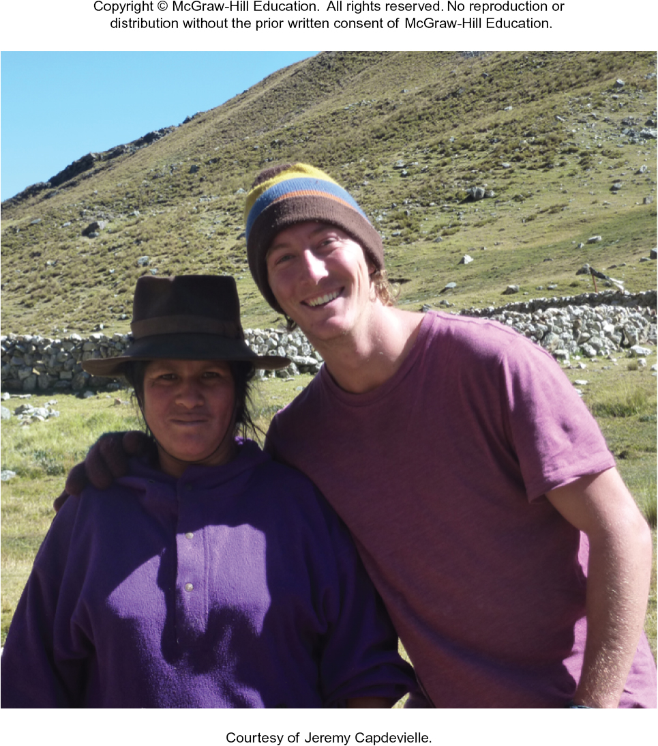
Get That Job! From Backpack to Briefcase
Jeremy Capdevielle
Jeremy Capdevielle took the plunge into international work by setting out on a half-year journey of exploration once he finished his undergraduate degree in entrepreneurship. He worked to save money for his trip and once he decided where to go—Panama, to begin—he went there and found jobs teaching English, while he worked on his Spanish. When he moved on to Ecuador, he began volunteer work with Great Aves.
Evaluate Jeremy’s advice to “challenge assumptions, observe the things that give you joy, and continually ask yourself—What do I love to do and how can I align this with a life that provides for what I need?”
Courtesy of Jeremy Capdevielle
Notes:
This approach may be seen as “typically American” by non-American students. It may well resonate with many American students.

Slide 42
MiniCase
The minicase “The BlueGreen Alliance: A New Way of Sustainability Thinking” discusses how 13 of the largest unions and environmental organizations in the United States are partnering to build a cleaner and fairer economy. Currently the alliance is focusing on three main issues: clean jobs, clean infrastructure, and fair trade.
Is the BlueGreen Alliance a partnership of convenience, or does it have the potential to build a new way of approaching sustainability, with limits, interdependence, and equity?
Unions may prefer protectionist measures to preserve jobs. Do you think this policy can fit a sustainable approach? Why or why not?
Notes:
1. BlueGreen Alliance is not a partnership of convenience, since, at least initially, they were opposed on many issues. Yet they did find common ground, and focusing on that, grew. Certainly it is a collaboration that has educated many in all organizations. And it may help all to see that recognizing limits, interdependence and equity is good for all. This is an opinion question, yet the possibility of a new way of thinking has been begun.
2. A protectionist approach, favoring domestic producers over foreign producers does not initially seem to involve equity or interdependence. So one approach to this opinion question would be to point that out and conclude that a protectionist approach is not compatible with a sustainable approach. One might also argue that support of local jobs that may involve protectionism would be a way to set limits and insure that equity at the local level exists. What matters in the answer to this question is a recognition that a sustainable approach involves limits, interdependence and equity.

Slide 43
End of Main Content

Slide 44
Accessibility Content: Text Alternatives for Images

Slide 45
Figure 4.1 C 2 C Model – Text Alternative
Return to parent-slide containing images.
This diagram consists of two circles, one labeled biological and the other labeled technical. The circles are joined at one side which is labeled animal consumption and is represented by people. The biological circle contains plants, nutrients, and decomposers. The technical circle contains synthetic materials, products, and manufacture.
Return to parent-slide containing images.

Slide 46
Figure 4.2 Context for Sustainability – Text Alternative
Return to parent-slide containing images.
This diagram consists of three overlapping circles labeled: social, economic, and environment. The characteristics of bearable, equitable, sustainable, and viable are shown as overlapping within these three circles. Bearable is located within the social and environment circles. Equitable is located within the social and economic circles. Viable is located within the environment and economic circles. Sustainable is located within all three circles.
Return to parent-slide containing images.

Slide 47
Figure 4.5 The Company in a Societal Context – Text Alternative
Return to parent-slide containing images.
The actions of a company are shown to 1. support workers and families, 2. use communal resources, 3. provide health care and education, 4. influence government, 5. consume limited resources, 6. provide goods and services, 7. pollute shared environments, 8. impact local economies.
Return to parent-slide containing images.

Slide 48
Figure 4.7 World Population Map – Text Alternative
Return to parent-slide containing images.
Higher population concentrations are shown in southeast Asia and parts of Africa. Mid-level population concentrations occur in North America, South America, and western Europe.
Return to parent-slide containing images.

Slide 49
Figure 4.9 World Energy Consumption by Fuel Type, 1990 to 2040 (est.) – Text Alternative
Return to parent-slide containing images.
Petroleum and other liquids have the highest consumption with steady growth predicted to continue.
Coal consumption rose steadily in past decades but is predicted to level off going forward.
Natural gas consumption is predicted to surpass coal consumption.
Renewable energy is predicted to have the greatest growth.
Nuclear energy has stagnated and is predicted to grow only slightly in the future.
Return to parent-slide containing images.

Slide 50
Figure 4.15 Worldwide Geothermal-Generating Capacity, 2000 to 2018 – Text Alternative
Return to parent-slide containing images.
In the year 2000, capacity was around 8,000. Capacity has risen steadily since then to a level of 12,013 in 2014 and jumping to 13,452 two years later in 2016.
Return to parent-slide containing images.

